Slide 1
SIWEs technical report
Attachment: Global Distance Learning Institute
By: Ganiyu Bolaji

Slide 2
Contents
Global Distance Learning Institute
Organizational Diagram
About the GDLI
Department Of Placement
Operations
Python class I taught
Skills Learnt
Task Assigned
Personal skills acquired
Experience acquired
Recommendation

Slide 3
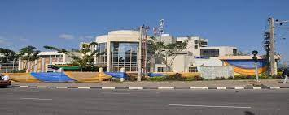
Global distance learning institute(Afrihub)
Was established in May 2004 to provide human capacity building technology
The companies vision is to strive to be dynamic, using state of the art technologies for excellence in service delivery, quality and customer’s value
The companies mission is to provide the critical combination of all required resources/knowledge to unleash the power of ICT and Trans-National Education (TNE)
The company provides educational
facilities and learning guidelines.

Slide 4
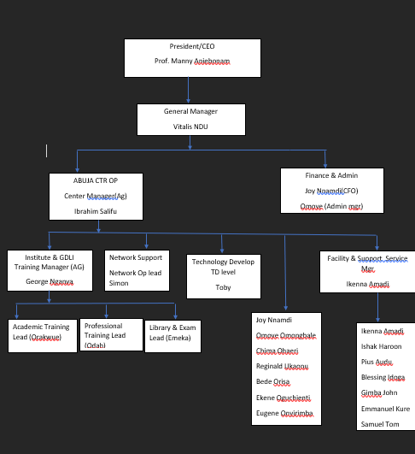
Organizational structure

Slide 5
What the company does
Provide tech solutions
Teach career building skills

Slide 6
Department Of placement
NOC department
Marketing department
Customer Care department

Slide 7
How I fit into the company
Being attentive to skills and instructions
Asked frequent questions
Worked as a team

Slide 8
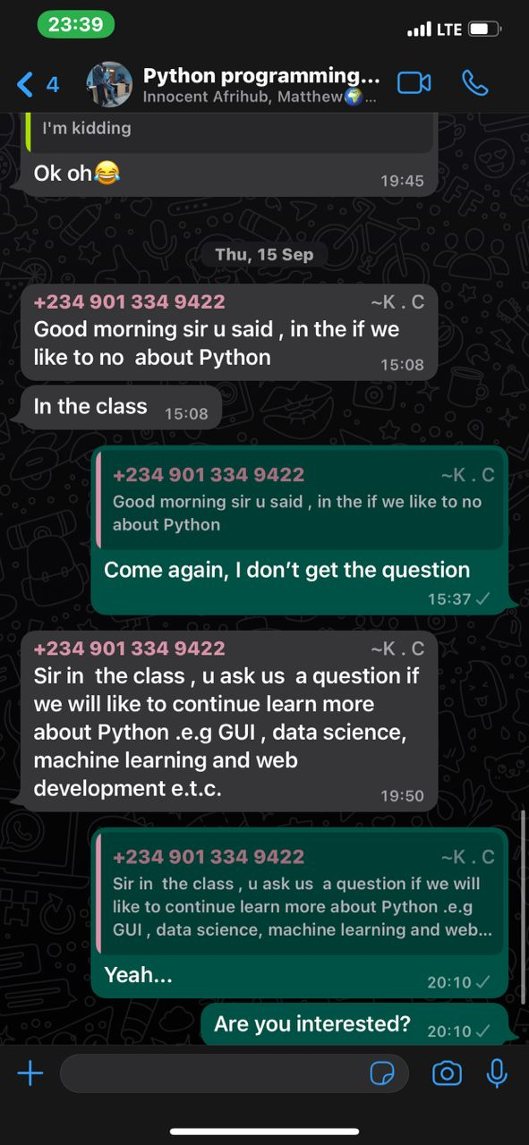
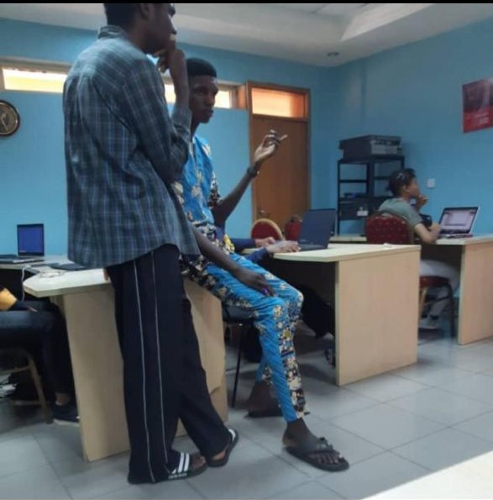
Python class I taught
Data types and variables
Conditional statements
Loops
Functions
Oop

Slide 9
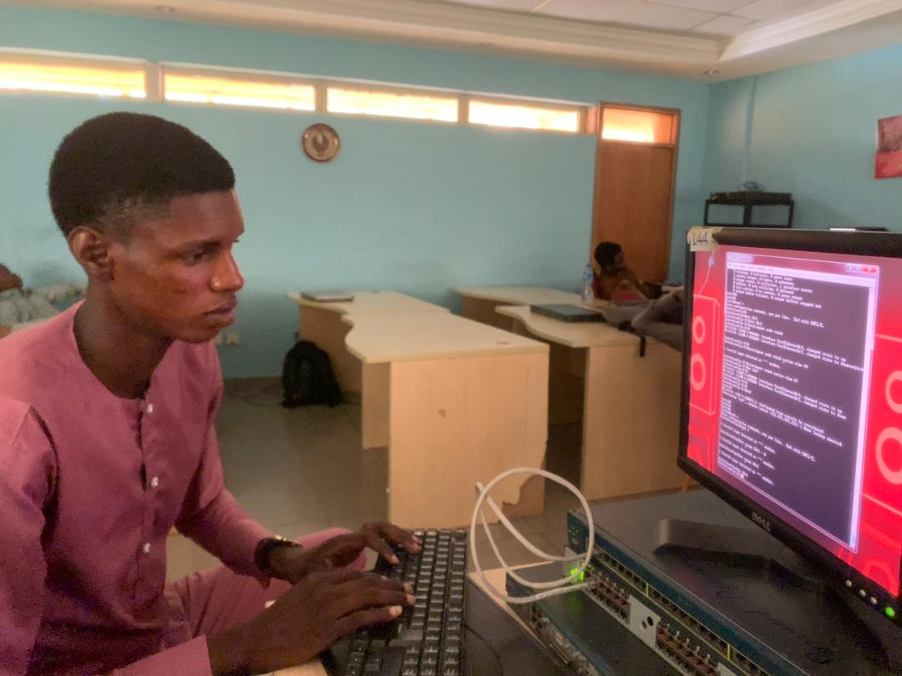
Skills Acquired
Networking Skills
Software Development Skills
Communication Skills
Marketing Skills

Slide 10
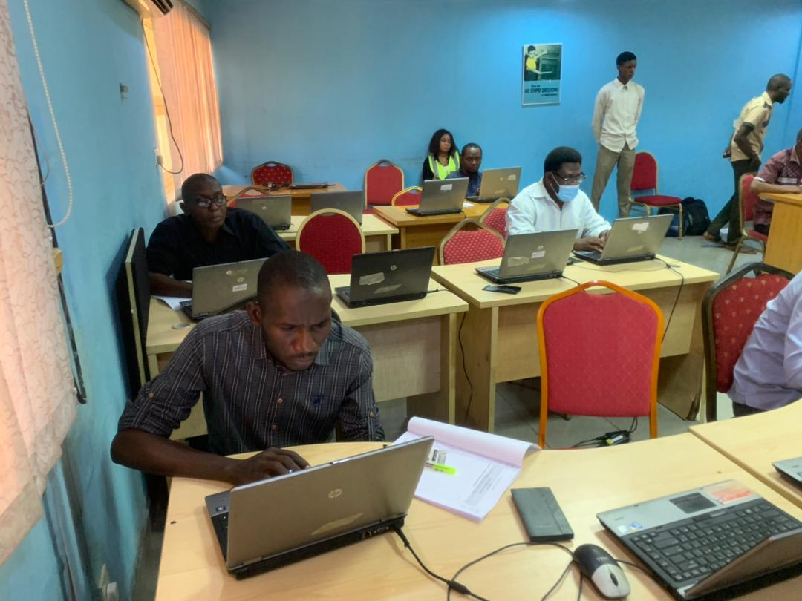
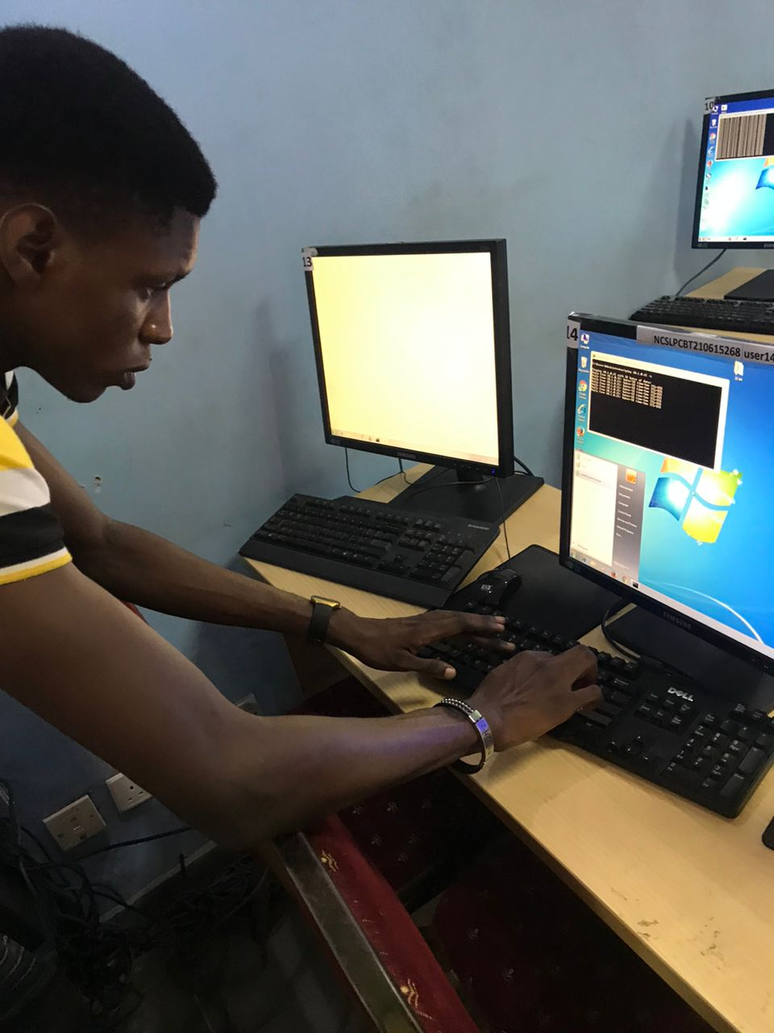
Tasks Assigned
Tech support JAMB and CBT Exams
Marketer (both traditional and systemized)
Customer Service
System Repairs
Taught Python Class

Slide 11
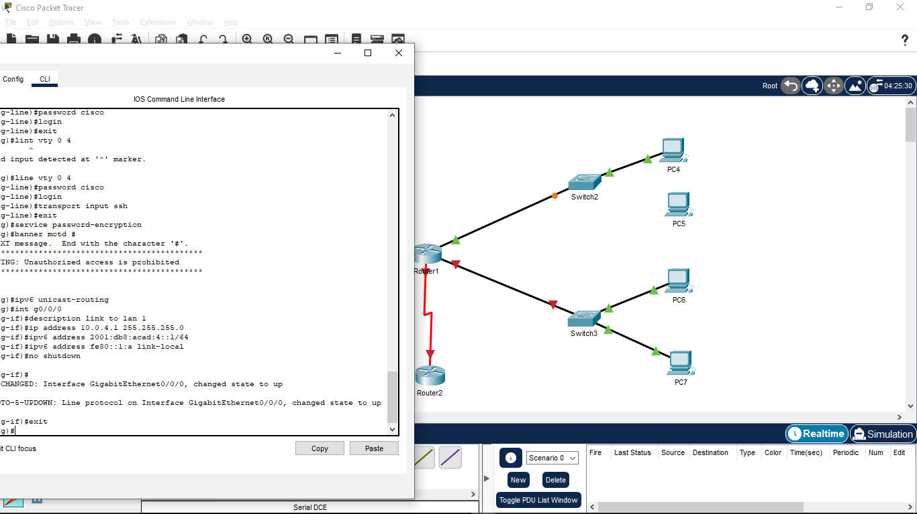
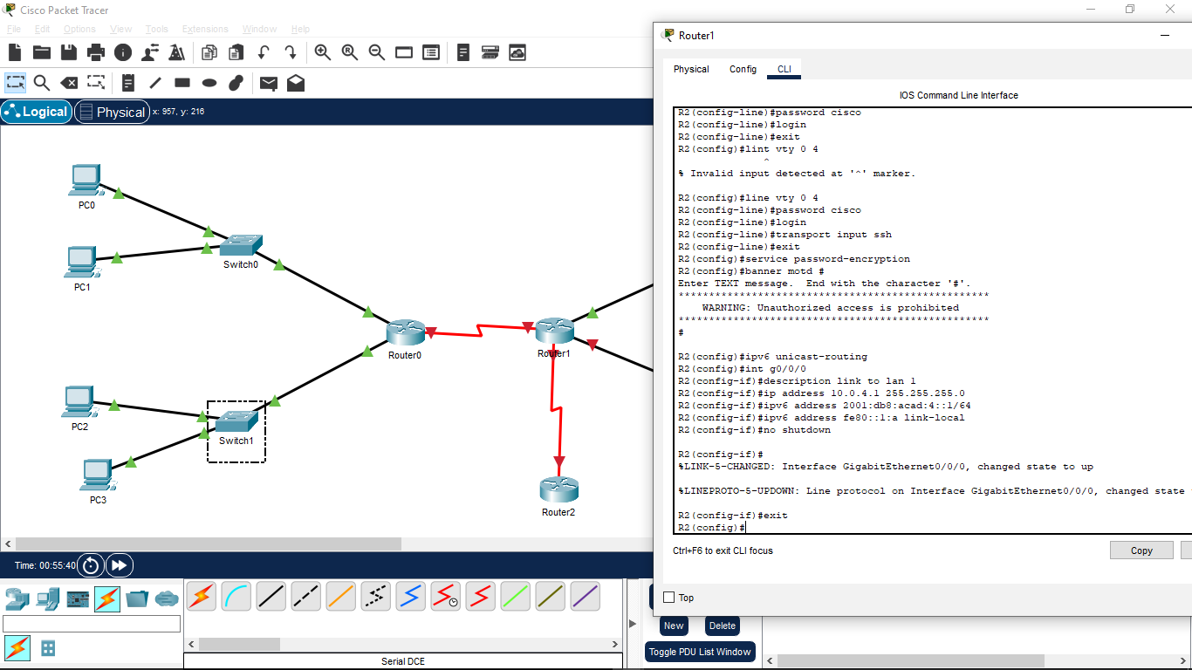
Personal skills acquired
Mobile development skills
Web development skills
GitHub collaboration
Networking skills

Slide 12
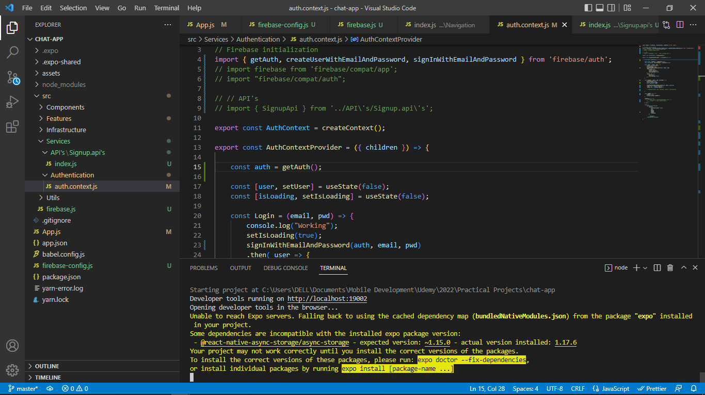
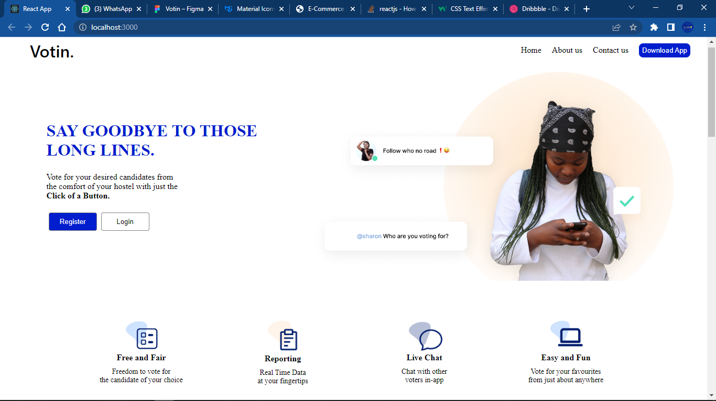
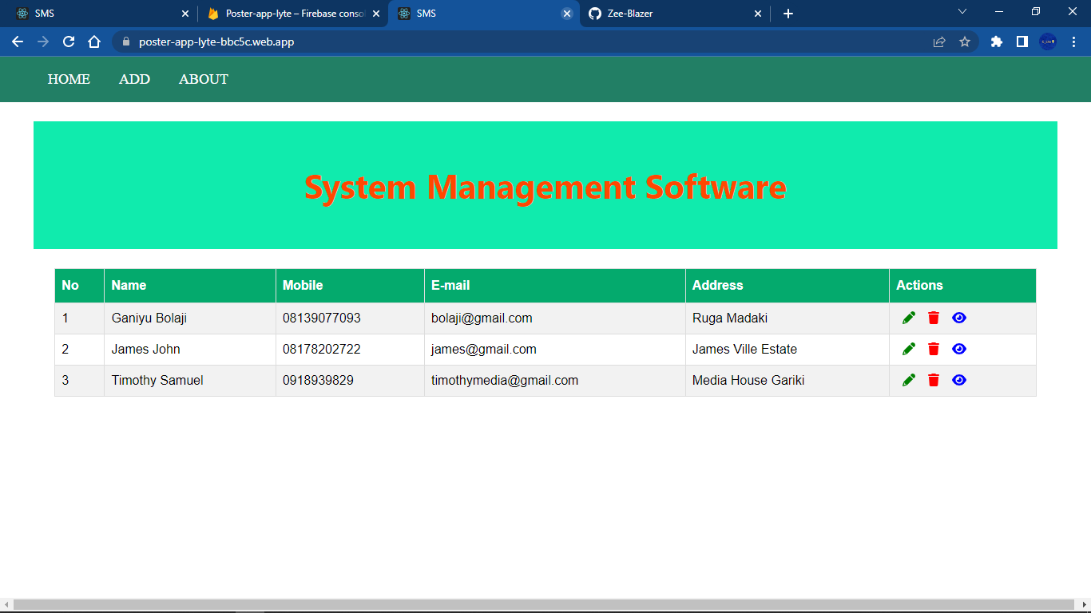
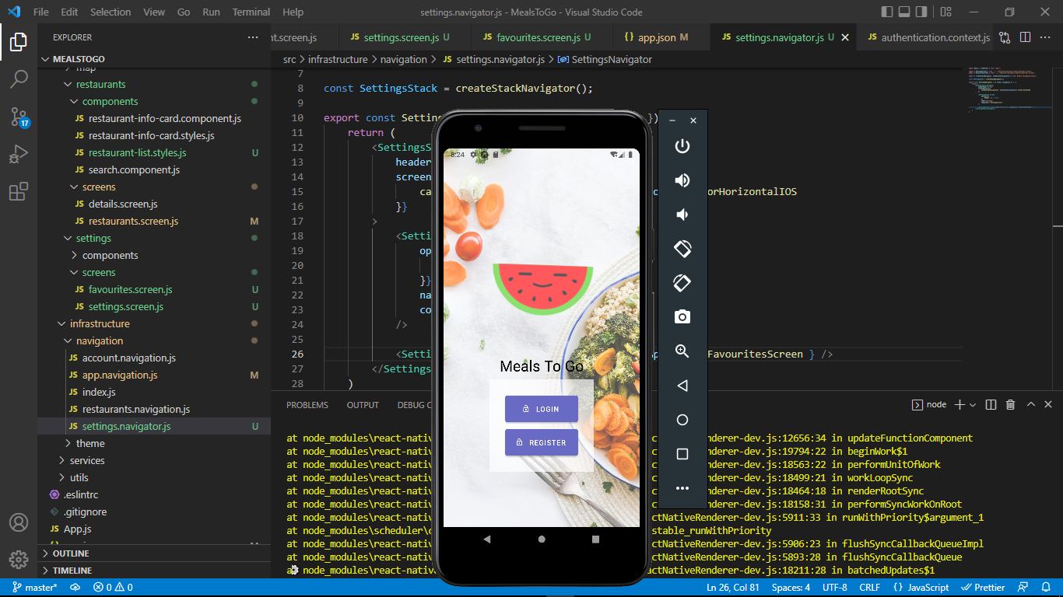
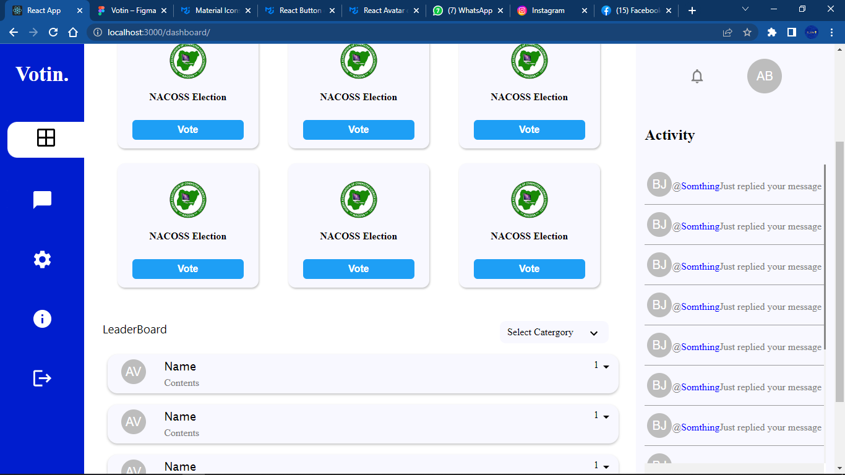
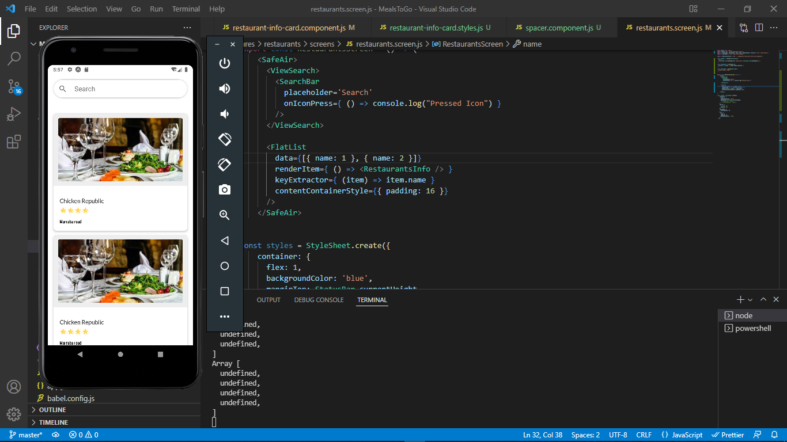
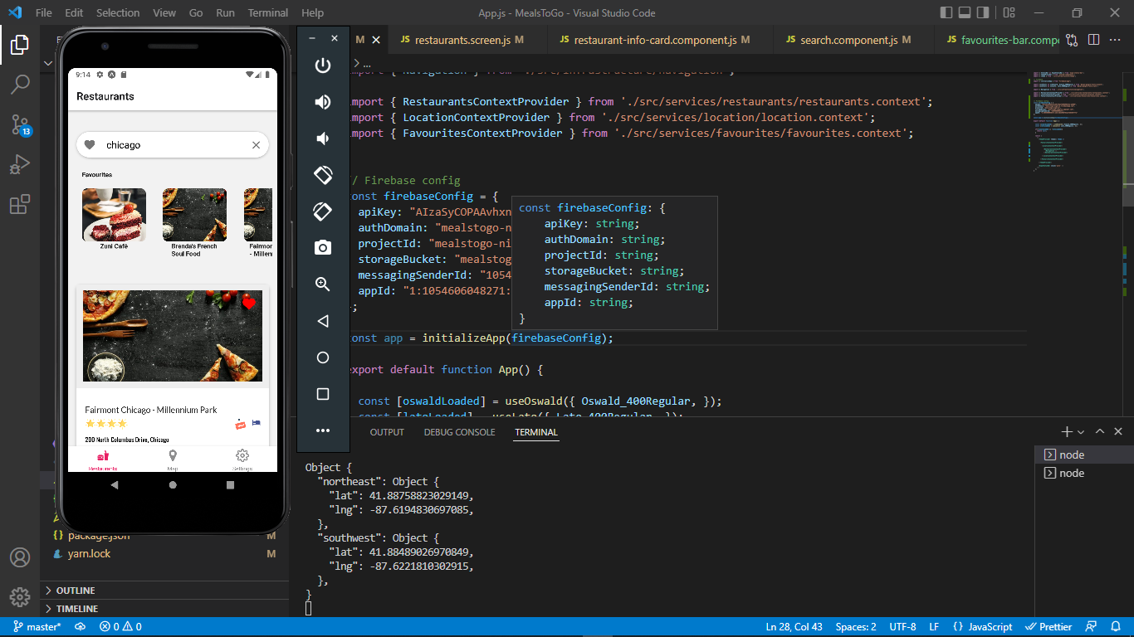
Web and mobile Dev Projects

Slide 13
Experience Acquired
Web and Mobile Skills
Networking and Marketing
React JS and React Native
Node JS and Firebase
Packet Tracer Simulation
Networking device configurations
Teaching Experience (Python)

Slide 14
recommendations
The company is the right place to acquire new skills
They provide helpful tech solutions
They are always open to work for affordable prices

Slide 15
Conclusion
The IT journey was an experience not to be ever forgotten not just for the skills I acquired but for the hands on experience on the devices and the development of the software I made in the company

